Slide 1
Anatomy of a flight

Slide 2

Session Aims
To understand what makes a high altitude flight - from the ground up.
To appreciate the importance of planning, permission and flexibility.

Slide 3
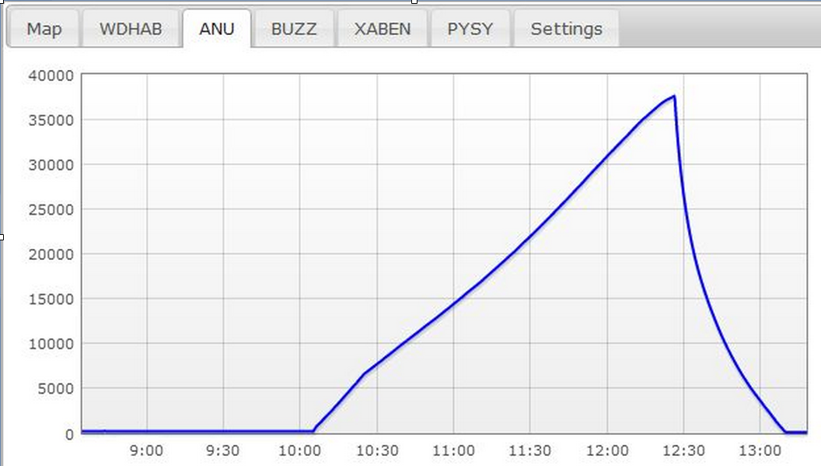
Flight Profile
You fill it
It goes up
You chase it
It bursts
It comes down
You find it

Slide 4
Complete Process
Project Aims
Where
Permission
Purchasing
Construction and setup - tracker, payload container
Testing (especially the tracking)
Predictions
Confirm permission request
Flight announcements
Fill and Launch
Chase

Slide 5
Permission / NOTAM
Choose a suitable site
Apply 28 days in advance
Request multiple days
Call to check a few days before launch
Cancel/change dates as necessary
Check the permission
Check the NOTAM
Check for restrictions
Check if you need to call ATC

Slide 6
Purchasing
Balloon Tracker
Radio receiver, aerial, cables
Payload box or sheets
Cord, duct tape, glue, cable ties
Filler - wastepipe, hose etc.
Balloon, Parachute
Groundsheet, scissors, cutters
Helium cylinder / valve/regulator

Slide 7
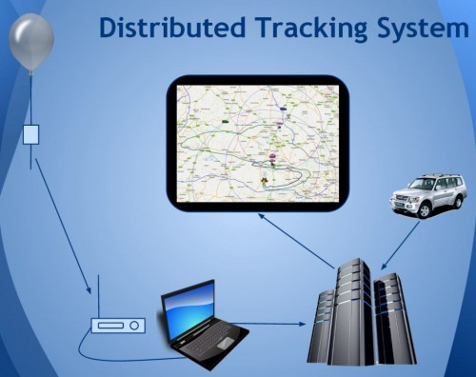
Radio Tracking System

Slide 8
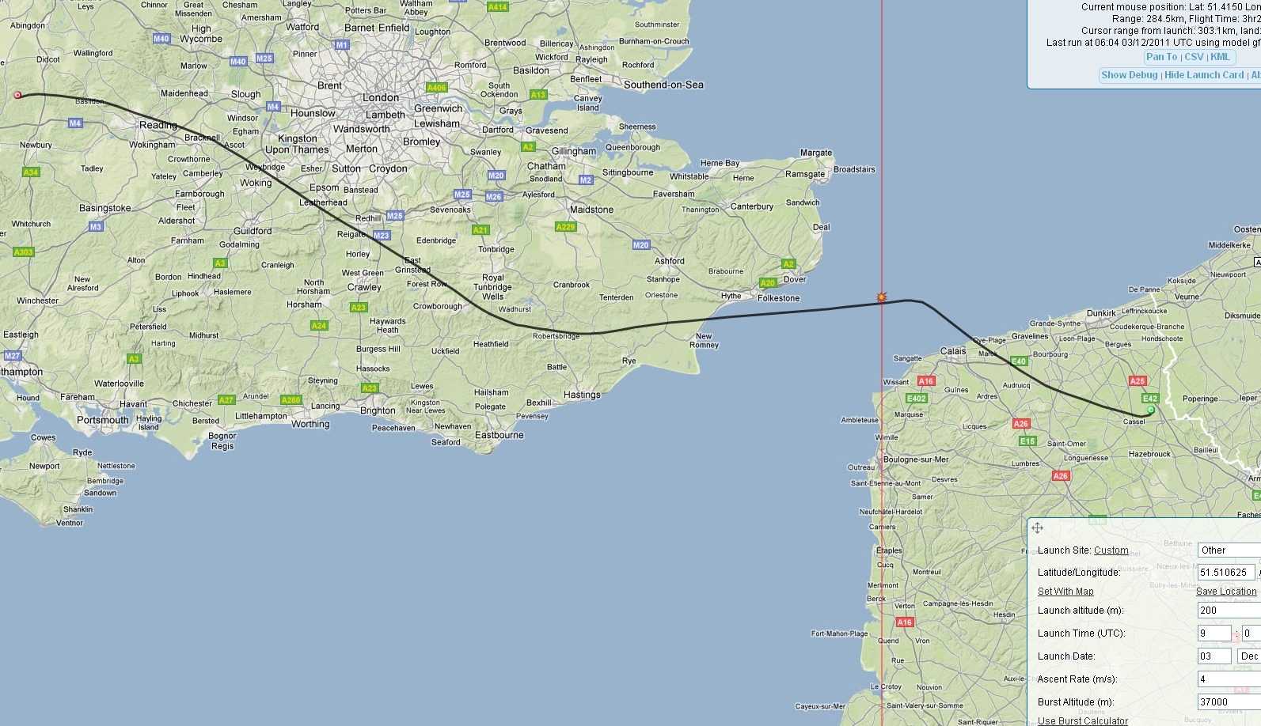
Flight Prediction

Slide 9
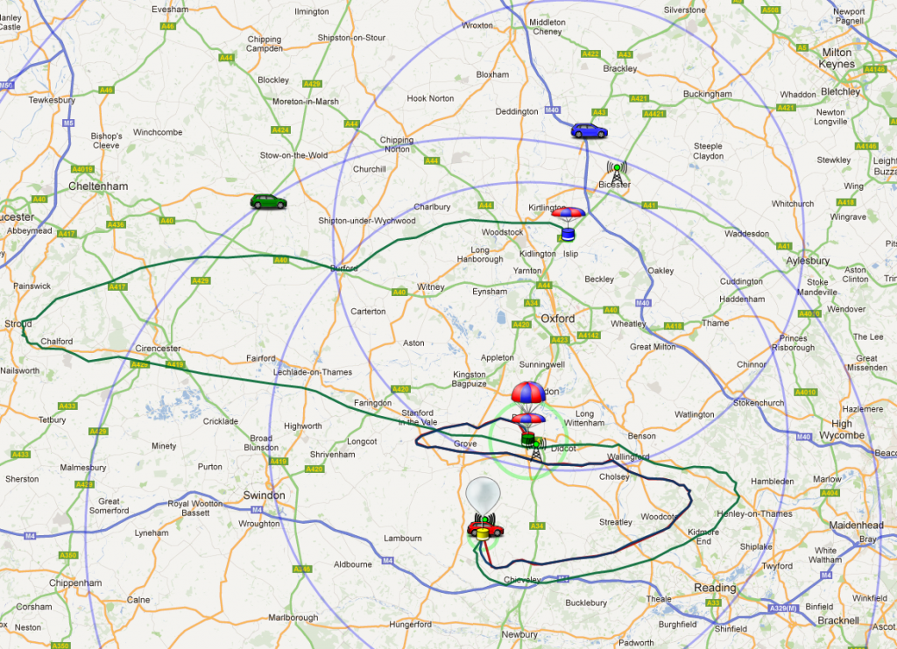
Typical Summer Flight Path

Slide 10
Launching
Unpack
Set up internet access
Start up tracker
Decode and upload
Close up payload
Flight train
Fill balloon
ATC ??
Sky clear ?
Launch!

Slide 11
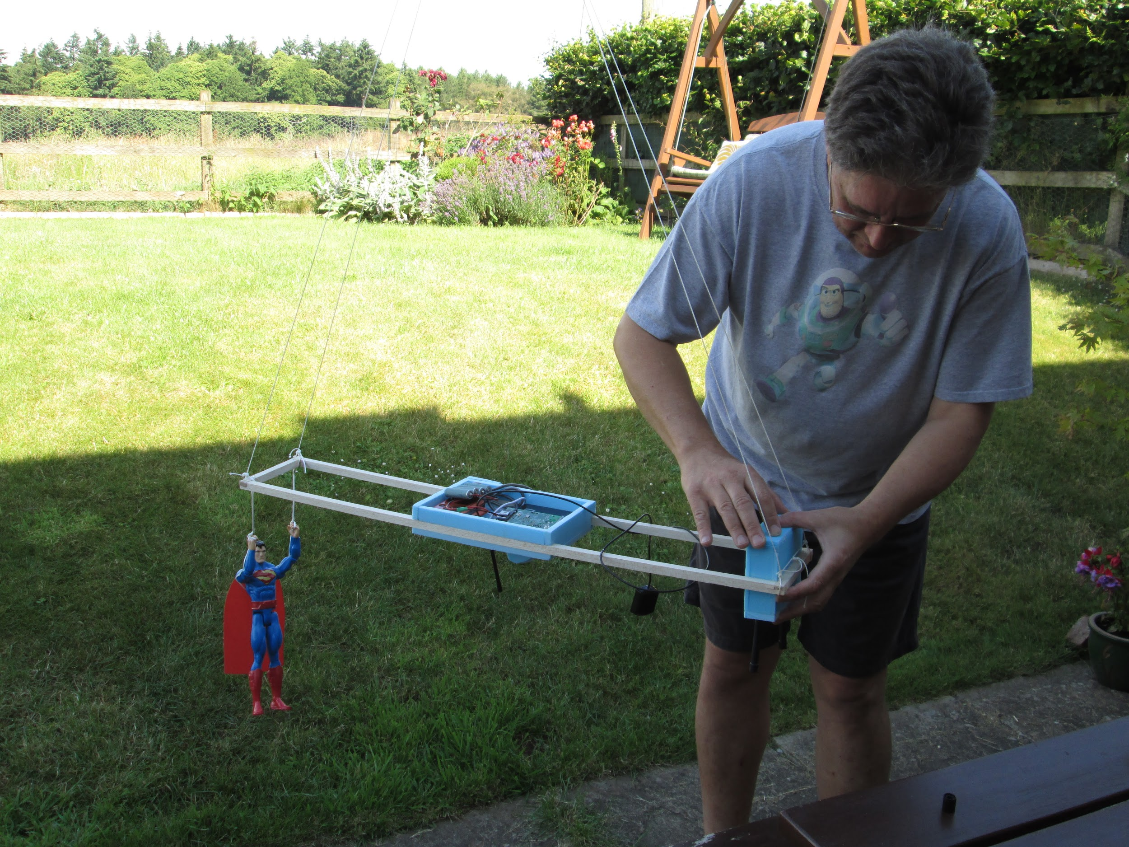

Slide 12
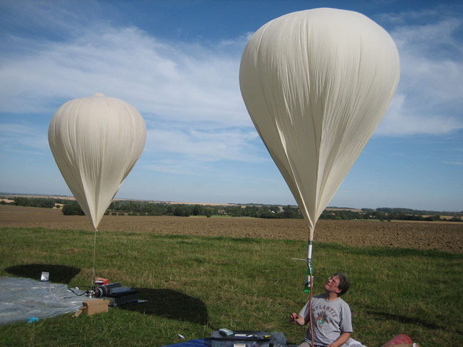

Slide 13
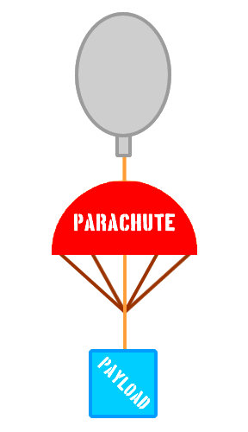
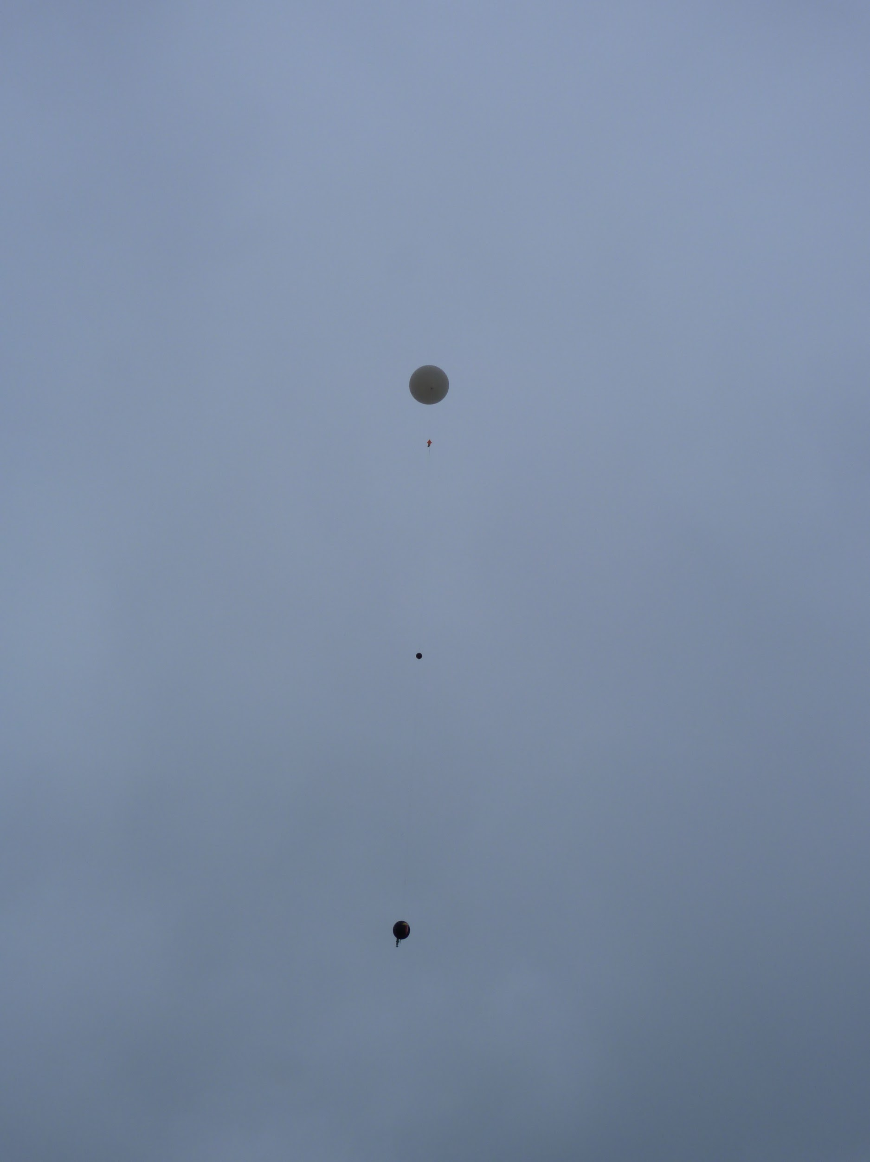

Slide 14
Chasing
Roles - Driver, Radio, Navigation, Comms
Before Burst: Drive to a suitable location with internet access and good radio signal, near predicted landing.
After Burst: Drive to update predicted landing spot
After Landing: Drive to latest position or prediction and decode landing position
After decode: Plan route by car/foot

Slide 15
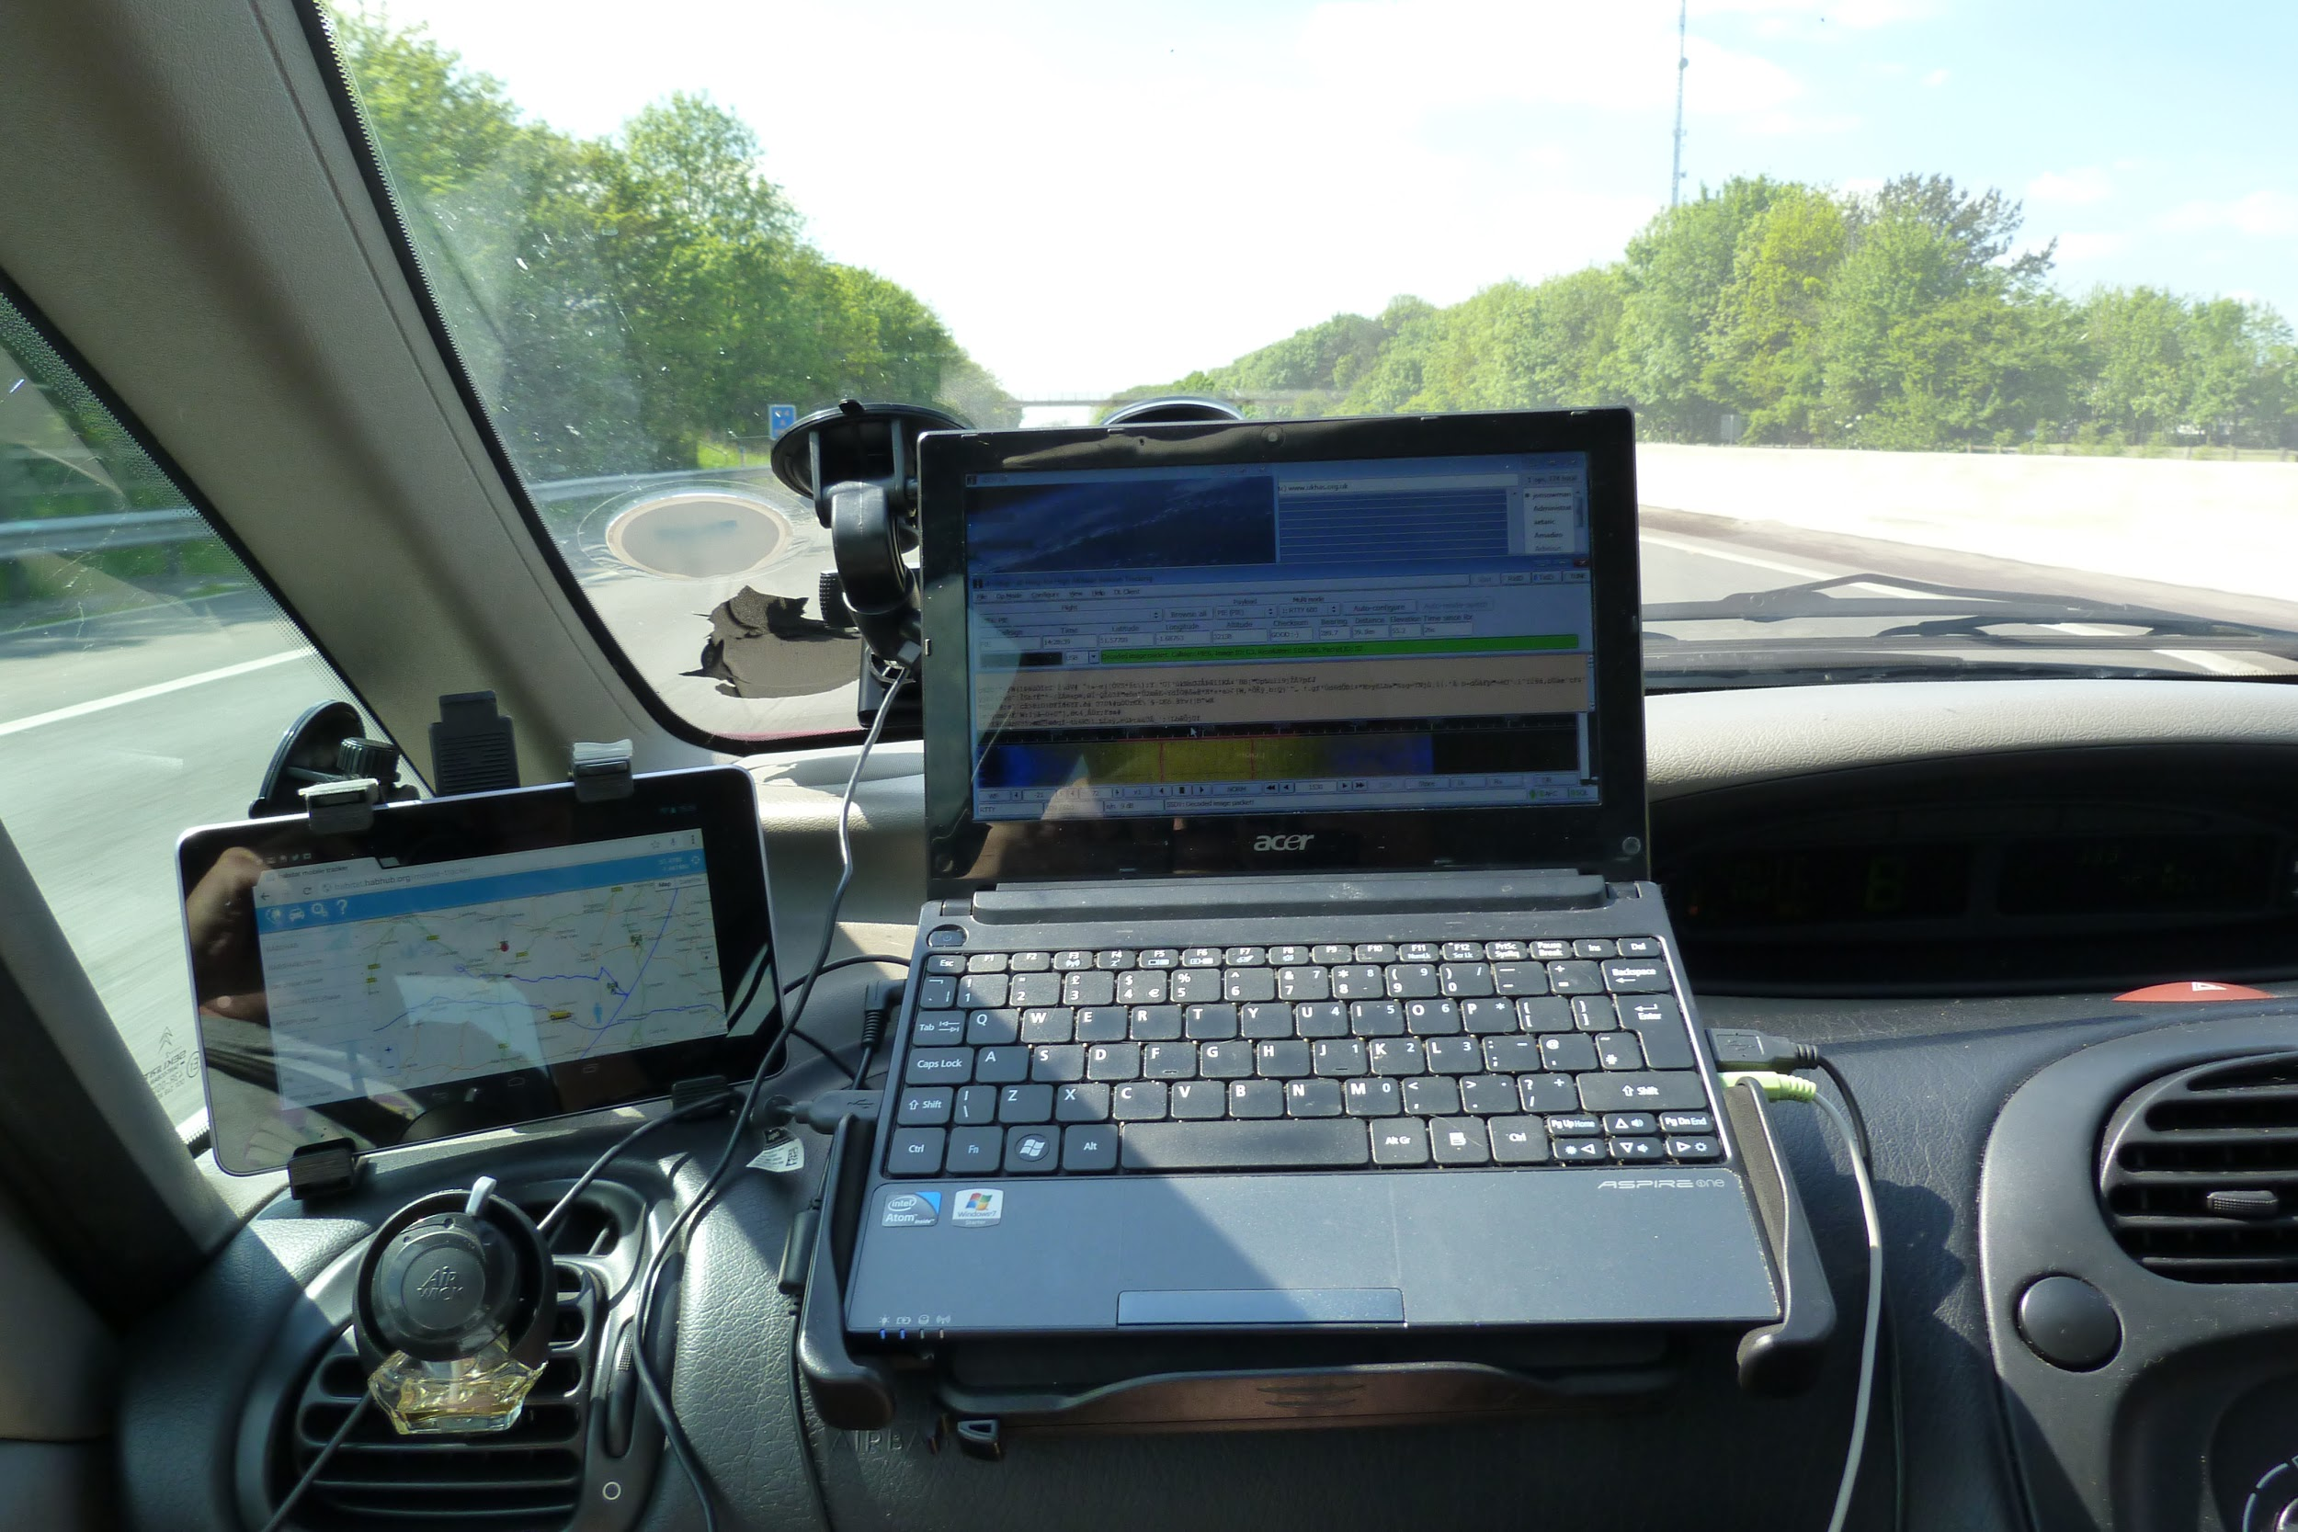

Slide 16
